Slide 1
Assignment
SHENGWEI LIU
S1037766
Cloth Recommend App

Slide 2
Total
Background: Weather has an important impact on clothing. Considering the differences between men and women, we have developed a program that can recommend suitable clothing for you on the day according to your gender and the region where you are located.
Intro: This project mainly recommends suitable clothes according to the user's gender and local climate.
Design pattern(Singleton): Use a unique reference to avoid the overhead of re-instantiation.
Params includes gender, country, age.
SDLC(Waterfall): Since the project is relatively small, a comprehensive design will not take too much time. So a more comprehensive design can be considered.

Slide 3
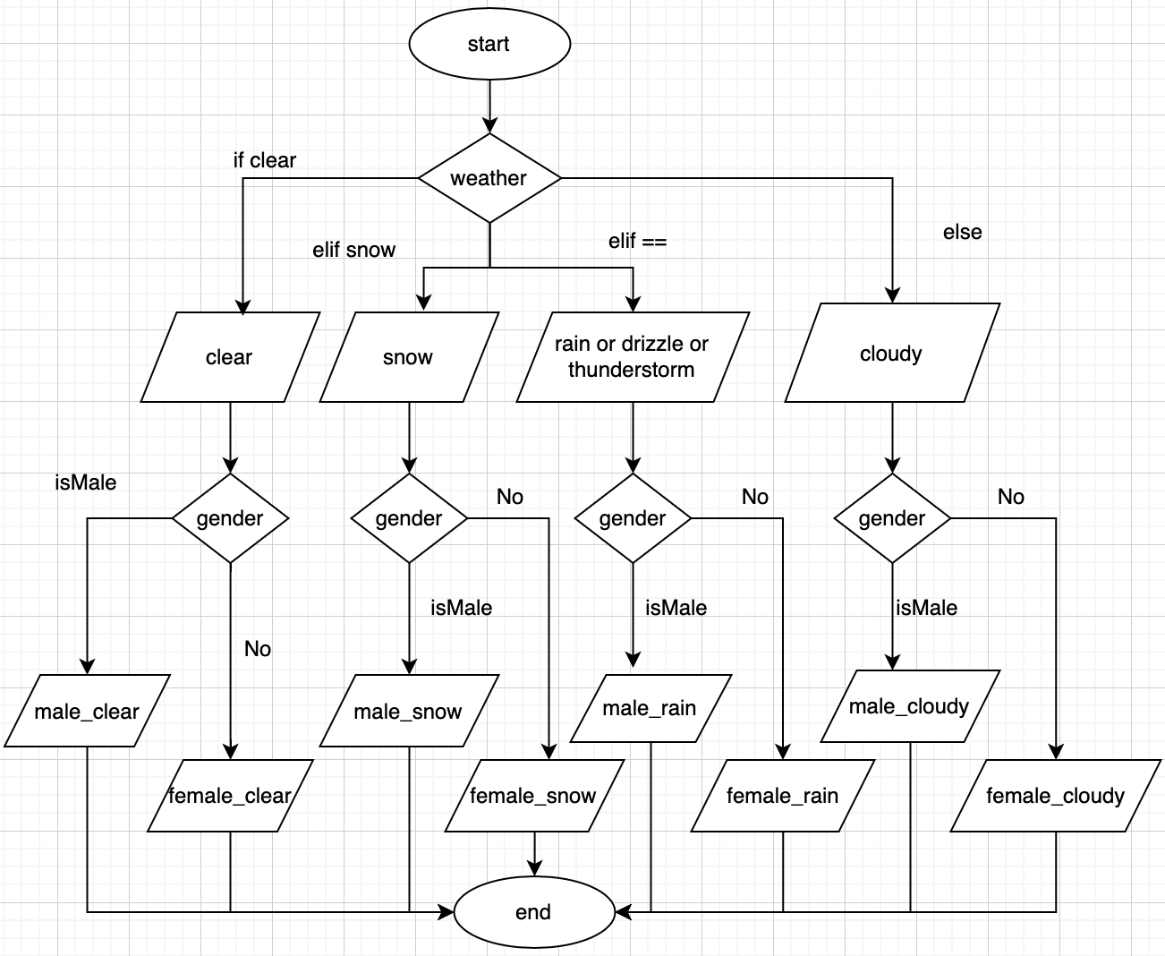
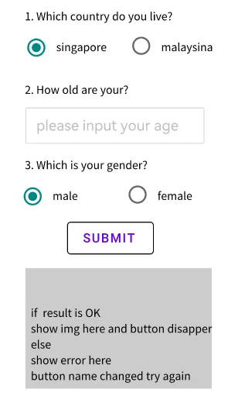
FlowChart on 2 of parameters
Wireframe

Slide 4
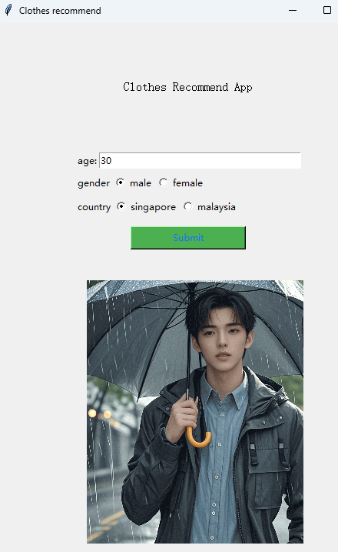
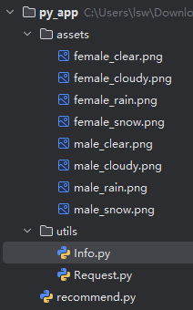
App page and Api
Api used
1.name: Weather Api
Provider: RapidAPI
document:https://rapidapi.com/worldapi/api/open-weather13
2.Description
Return weather-related information of the local area according to the input country.
Constructor
assets: img resources
utils:tools
------Info function and varibles
------Request: request singleton class
recommend:

